Slide 1
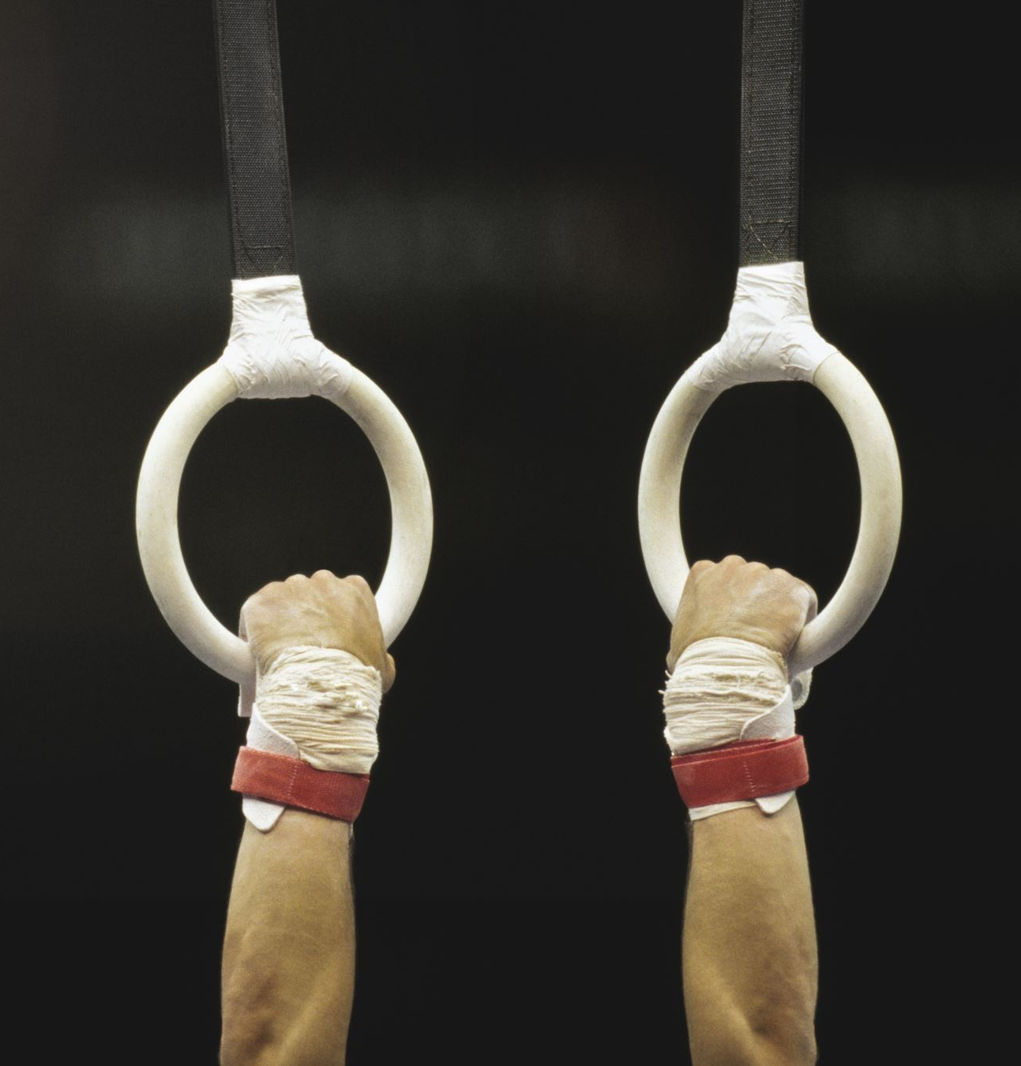
Optimizing USA Olympic Gymnastics Team Selection Using Data Analytics By: Ryan talbot
Notes:
Hi my name is Ryan Talbot and my presentation is ‘optimizing usa Olympic gymnastics team selections using data analytics’. I chose this topic after stumbling on a competition put on by the university of Connecticut. Called the Uconn Sports Analytics symposim. The Data challenge is separated into 2 levels high school, and undergraduates compete against one another and separate from them are graduate students.
For this data challenge, the goal is to identify the group of 5 athletes who will enable the USA Olympic Men’s and Women’s Artistic Gymnastics teams to optimize success in Paris 2024. You are tasked with developing an analytics model that can be used to identify and compare the expected medal count in the 8 medal events for men (team all-around, individual all-around, floor exercise, pommel horse, still rings, vault, parallel bars, and high bar) and 6 medal events for the women (team all-around, individual all-around, vault, uneven bars, balance beam, and floor exercise).
The goal of this data challenge is to put together the best possible men’s and women’s Team USA Olympic Artistic Gymnastics teams, however, the meaning of “best” is left open to the interpretation of the entrant.

Slide 2
Brief overview of the research goal
Selecting the optimal Men's and Women's USA Olympic Artistic Gymnastics teams for the 2024 Olympics.
Notes:
Abstract
Utilizing data spanning from 2013 to 2023 from a diverse range of sources, this
research employs data scraping, cleaning, exploratory data analysis (EDA), and
modeling to identify the optimal Men's and Women's Teams and Individual USA
Olympic Artistic Gymnasts for the 2024 Olympic Games. The term "best" is defined as
maximizing the total medal count in artistic gymnastics for the United States. The study
integrates machine learning models, combinatorial optimization algorithms, and
advanced data analysis techniques. Initial phases focus on predicting individual
apparatus outcomes using binary classification, with evaluation based on key metrics
such as accuracy, precision, recall, F1-Score, and F2-Score. During my investigation
into team selection optimization, mixed-integer linear programming was a recurring
theme. However, my research diverges from the norm as I embrace a novel approach
that leverages Metaheuristics Algorithms, specifically Randomized Heuristic, Tabu
Search, and Variable Neighborhood Search (VNS). Grounded in data analysis and
algorithmic decision-making, the research strategically positions Team USA to
maximize their medal count in the Paris 2024 Olympics

Slide 3

Research Objectives
Notes:
This research focuses on selecting the optimal Men's and Women's USA
Olympic Artistic Gymnastics teams for the Paris 2024 Olympics, aiming to
position Team USA for maximum medal count. The challenge involves
identifying exceptional athletes for each team, considering both individual and
team event success. Leveraging advanced analytics models, this study
forecasts and compares medal counts, providing a data-driven foundation for
strategic decision-making in the 2024 Olympic Games.
To determine the "best" gymnasts, baseline models for individual apparatus
outcomes are established, with the ZeroR algorithm as a foundational
benchmark. Various machine learning models, including Random Forest
Classifier, AdaBoost Classifier, Support Vector Classifier (SVC), K Neighbors
Classifier, Decision Tree Classifier, Gaussian Naïve Bayes, and Neural
Networks, comprehensively assess individual gymnasts' performance and
influencing factors.
Optimal team selection involves navigating complexities with optimization
algorithms such as Randomized Heuristics, Stochastic Control, Tabu Search,
Variable Neighborhood Search, and Brute Force. These algorithms play a
pivotal role in optimizing team selection to maximize point totals.
Based on a diverse dataset spanning 2015 to 2023 from reputable platforms
like Thegymter.net, Wikipedia.org, and the UConn Sports Analytics Symposium
2024, the study integrates machine learning models, optimization algorithms,
and comprehensive data analysis. The goal is to provide Team USA with a
strategic advantage to maximize their medal count in the Paris 2024 Olympics

Slide 4
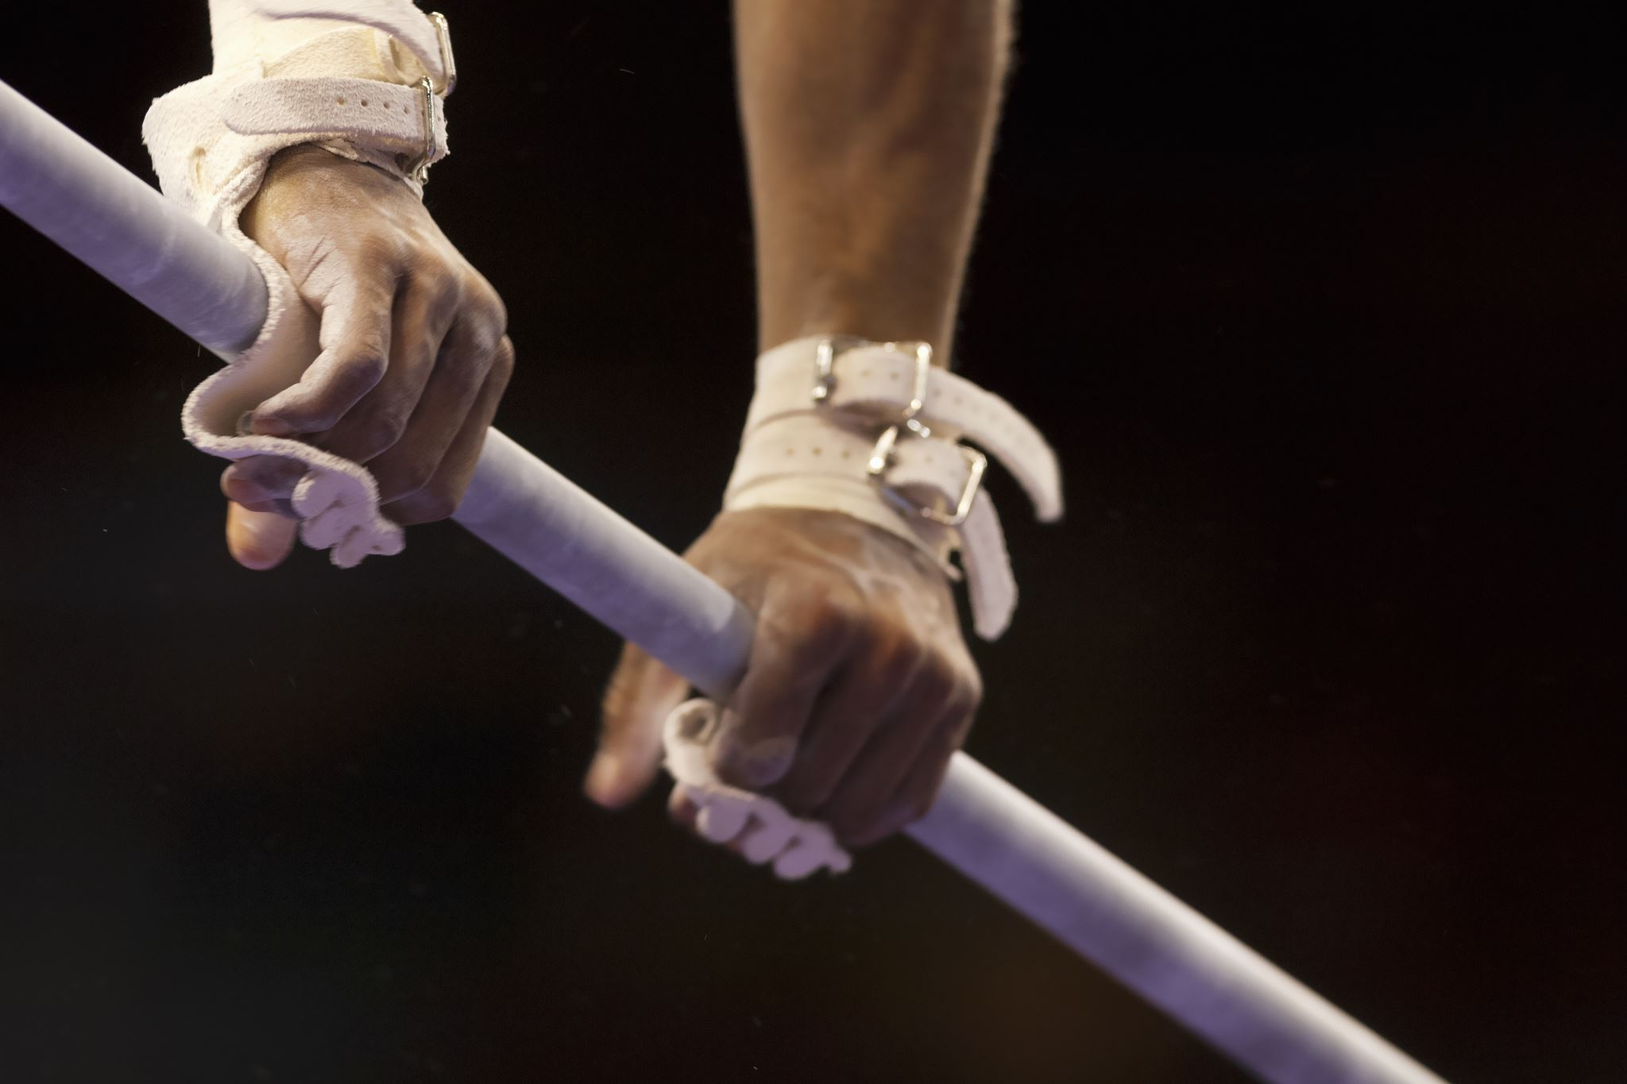
Data Sources
Notes:
This research derives its data from reputable platforms such as
Thegymter.net, UCSAS 2024 USOPC Data Challenge, and
Wikipedia.org. The dataset spans from 2013 to 2023, focusing primarily
on international competitions like world cups, world championships, and
the Olympics. Key data includes individual scores, overall
performances, event rankings, athlete details, and various scores
(execution, difficulty, penalties). Due to time constraints, the primary
emphasis in data collection lies on the years 2023 and 2022, resulting
in a substantial dataset, albeit one that may not be as exhaustive as
ideal.

Slide 5
Data Preprocessing
Steps in data cleaning and integration.
Challenges faced with data imbalances and strategies for robust modeling.
Notes:
The data preprocessing stage is crucial for ensuring dataset integrity
and usability. In the 'Scraping' directory, web scraping code generates
CSV files of raw data. The 'Cleaning' directory addresses tasks like
filling/removing missing values and standardizing column names. The
'Combine Data' directory facilitates the integration of information from
diverse competitions for each event, offering a comprehensive
perspective. Acknowledging dataset imbalances, especially in the
minority class, poses challenges. Therefore, Robust models for
imbalanced datasets will be employed to ensure fair and accurate
representation across classes. These preprocessing steps transform
raw data into a clean, structured, and uniform dataset for accurate and
insightful analysis.

Slide 6
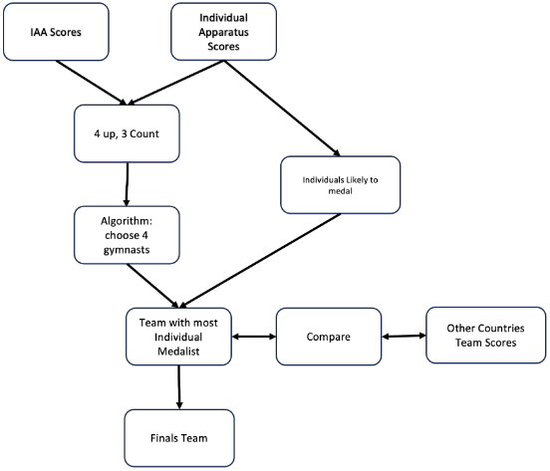
Methodology Overview
Individual
Models
Hyperparameter Tuning
Cross-validation Strategies
Base Model
Confusion Matrix
Team
Qualification Round
Men’s Team Selection
Women’s Team Selections
Finals
Notes:
The methodology for optimizing team and individual performances in artistic gymnastics for the USA involves leveraging machine learning and combinatorial optimization techniques. At the individual level, various machine learning models such as Random Forest, AdaBoost, SVC, K-Neighbors, Decision Tree, Gaussian Naïve Bayes, and Neural Networks were utilized to predict individual apparatus outcomes. Hyperparameter tuning was enhanced through Grid Search, while holdout validation and k-fold cross-validation ensured robust model evaluation. The ZeroR classifier served as a baseline for performance comparison, and a confusion matrix provided insights into model proficiency with metrics like accuracy, precision, F1-Score, and F2-Score.
At the team level, two datasets were employed: one for comprehensive all-around scores and another for individual apparatus scores. During the qualification round, a "4 up 3 counts" strategy was implemented, where the top three scores from four athletes were considered. Algorithms such as Tabu Search, Randomized Heuristic, and Variable Neighborhood Search were used for both men's and women's team selections. In the finals, a "3 up 3 counts" structure was utilized, where three gymnasts' scores contributed to the final team score. Selection criteria were based on Individual All-Around (IAA) scores, ensuring the inclusion of potential individual medalists in the final roster.

Slide 7
Individual Apparatus Modeling
Models
Metrics for Evaluation
Random Forest Classifier
AdaBoost Classifier
Support Vector Classifier (SVC)
K-Neighbors Classifier
Decision Tree Classifier
Gaussian Naïve Bayes
Neural Networks
Accuracy
Precision
Recall
F1-Score,
F2-Score
Notes:
Random Forest Classifier
A Random Forest is an ensemble learning method that constructs multiple decision trees during training and outputs the mode of the classes (classification) or mean prediction (regression) of the individual trees. It helps to reduce overfitting and improves the predictive performance.
AdaBoost Classifier
AdaBoost (Adaptive Boosting) is an ensemble method that combines the predictions of several base estimators (often weak learners like decision trees) to improve robustness. It adjusts the weights of incorrectly classified instances so that subsequent classifiers focus more on difficult cases.
Support Vector Classifier (SVC)
SVC is a type of Support Vector Machine (SVM) used for classification tasks. It works by finding the hyperplane that best separates the data into different classes, maximizing the margin between the nearest points (support vectors) of the classes.
K-Neighbors Classifier
The K-Neighbors Classifier is a type of instance-based learning where the function is approximated only locally, and all computation is deferred until function evaluation. It classifies a sample based on the majority class among its k-nearest neighbors in the feature space.
Decision Tree Classifier
A Decision Tree Classifier is a tree-like model used to make decisions based on input features. It splits the data into subsets based on the value of input features, with the aim of achieving the most homogeneous subsets, allowing for straightforward interpretation and visualization.
Gaussian Naïve Bayes
Gaussian Naïve Bayes is a variant of the Naïve Bayes algorithm that assumes that the features follow a Gaussian (normal) distribution. It's particularly useful for continuous data and is based on Bayes' Theorem with the assumption of feature independence.
Neural Networks
Neural Networks are computational models inspired by the human brain, consisting of layers of interconnected nodes (neurons). They are capable of capturing complex patterns in data by adjusting weights through training, commonly used in deep learning for tasks such as image recognition, natural language processing, and more.
Accuracy is a metric that indicates the overall correctness of a model by measuring the proportion of true results (both true positives and true negatives) among the total number of cases examined.
Precision measures the proportion of true positive results in the set of all positive predictions made by the model. It indicates how many of the predicted positive instances were actually positive
Recall (also known as Sensitivity or True Positive Rate) measures the proportion of actual positive cases that were correctly identified by the model. It indicates how well the model can identify positive instances
F1-Score is the harmonic mean of Precision and Recall. It provides a single metric that balances both the precision and recall of the model, especially useful when you need a balance between the two.
F2-Score is similar to the F1-Score but gives more weight to Recall than Precision. This is useful in scenarios where missing positive cases (false negatives) is more critical than incorrectly identifying negatives as positives (false positives).

Slide 8
Team Selection Strategy Men's
Algorithms
Tabu Search
Randomized Heuristic
Variable Neighborhood Search (VNS)
Notes:
Team
In the process of team selection, two distinct datasets were employed.
The initial dataset prioritized comprehensive all-around scores, while
the second dataset focused on individual apparatus scores for USA
gymnasts.
3.2.1. Qualification Round
The qualification round uses 4 up 3 counts, where four athletes
will compete on each apparatus. The cumulative total of the
three highest scores on each apparatus determines the
advancing teams. Several algorithms were used with the same
goal in mind; to get the three highest scores from four gymnasts.
3.2.1.1. Men's team selection
Tabu Search, Randomized Heuristic, and Variable
Neighborhood Search algorithms were used,
incorporating data from 2022 to 2023. In case of multiple
entries, the maximum score was chosen, capturing each
gymnast's optimal potential.
3.2.1.2. Women's team selection
Tabu Search, Randomized Heuristic, Variable
Neighborhood Search, and Brute Force algorithms were
used with datasets from 2022 to 2023. For multiple
entries, the mean score was used for Team USA,
ensuring reliability in assessing each gymnast's
performance. In case of multiple entries for other
countries, the maximum score was chosen, capturing
each gymnast's optimal potential. While it may appear
unfair, the forthcoming observation will demonstrate that
Team USA simply outperforms all other countries by a
significant margin. (The maximum scores for Team USA
were initially employed, establishing a significant lead of
over 4.5 points ahead of the second-place contender.)
3.2.2. Finals
A 3 up 3 count structure in the finals involves three gymnasts
per apparatus, with cumulative scores contributing to the final
team score. Selection criteria were based on Individual
All-Around (IAA) scores, concurrently considering the inclusion
of potential individual medalists in the final roste

Slide 9
Team Selection Strategy women's
Algorithms
Tabu Search
Randomized Heuristic
Variable Neighborhood Search (VNS)
Brute Force
Notes:
Team
In the process of team selection, two distinct datasets were employed.
The initial dataset prioritized comprehensive all-around scores, while
the second dataset focused on individual apparatus scores for USA
gymnasts.
3.2.1. Qualification Round
The qualification round uses 4 up 3 counts, where four athletes
will compete on each apparatus. The cumulative total of the
three highest scores on each apparatus determines the
advancing teams. Several algorithms were used with the same
goal in mind; to get the three highest scores from four gymnasts.
3.2.1.1. Men's team selection
Tabu Search, Randomized Heuristic, and Variable
Neighborhood Search algorithms were used,
incorporating data from 2022 to 2023. In case of multiple
entries, the maximum score was chosen, capturing each
gymnast's optimal potential.
3.2.1.2. Women's team selection
Tabu Search, Randomized Heuristic, Variable
Neighborhood Search, and Brute Force algorithms were
used with datasets from 2022 to 2023. For multiple
entries, the mean score was used for Team USA,
ensuring reliability in assessing each gymnast's
performance. In case of multiple entries for other
countries, the maximum score was chosen, capturing
each gymnast's optimal potential. While it may appear
unfair, the forthcoming observation will demonstrate that
Team USA simply outperforms all other countries by a
significant margin. (The maximum scores for Team USA
were initially employed, establishing a significant lead of
over 4.5 points ahead of the second-place contender.)
3.2.2. Finals
A 3 up 3 count structure in the finals involves three gymnasts
per apparatus, with cumulative scores contributing to the final
team score. Selection criteria were based on Individual
All-Around (IAA) scores, concurrently considering the inclusion
of potential individual medalists in the final roste

Slide 10
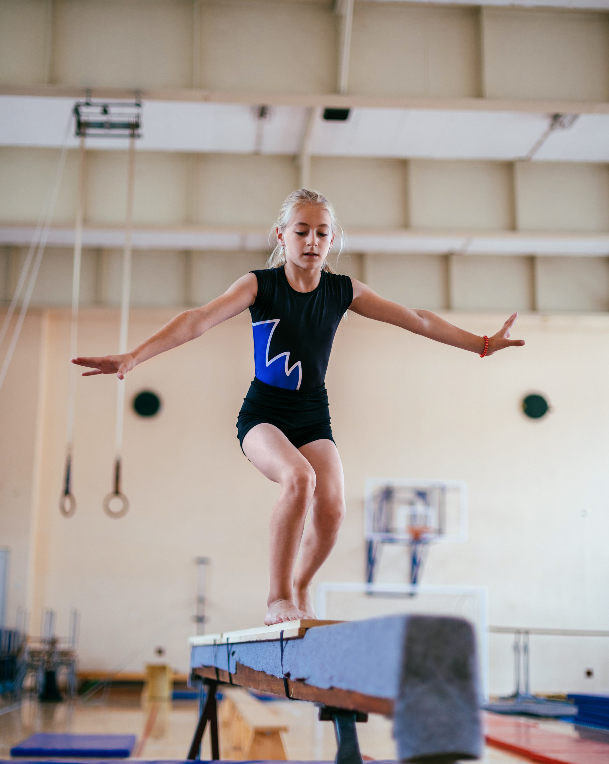
Finals
In the finals, a "3 up 3 count" structure used three gymnasts' scores per apparatus, with selection based on Individual All-Around (IAA) scores and potential individual medalists.
Notes:
A 3 up 3 count structure in the finals involves three gymnasts
per apparatus, with cumulative scores contributing to the final
team score. Selection criteria were based on Individual
All-Around (IAA) scores, concurrently considering the inclusion
of potential individual medalists in the final roster

Slide 11
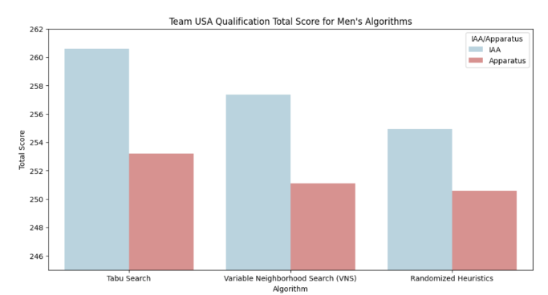
Evaluation Metrics Men’s
Notes:
Individual Apparatus Evaluation and Results
This analysis draws upon historical data encompassing Men's and
Women's international gymnastics competitions. The models for
Women were trained on data spanning from 2013 to 2021, while the
models for Men were trained on a more limited timeframe from 2018 to
2020, due to time constraints. The evaluation of the models involves the
utilization of unseen data from the years 2022 and 2023 for inference.
4.2. Model Performance Metrics
For each apparatus, the data was run through the various models
(3.1.1.), and their accuracy, precision, F1-scores, and F2-scores were
compared. Once the best model was selected, judged by its accuracy
and F2-score, it was optimized using grid search for parameter tuning.
From there the data was scrutinized with feature importance. Although
the option of feature scaling was contemplated, the utilization of
AdaBoost and Random Forest classifiers for binary classification
demonstrated resilience to fluctuations in feature scales. As a result,
explicit scaling was deemed unnecessary in the analytical process. The
models underwent additional iterations to evaluate the potential for
improvements.
In addition to accuracy, I also evaluated the classifiers based on the
F2-score metric. The F2-score considers both precision and recall, with
a higher weight given to recall. It measures the overall effectiveness of
the classifier in selecting top gymnasts while minimizing false negatives.
The findings indicate that, across various gymnastics events, both the
Random Forest and AdaBoost classifiers consistently demonstrated
high accuracy. Moreover, both classifiers consistently attained elevated
F2-scores, emphasizing their proficiency in accurately identifying top
performers.
In summary, the Random Forest and AdaBoost classifiers consistently
demonstrated high accuracy and F2-scores in the selection process for
Team USA gymnasts. These findings highlight the effectiveness of
these classifiers in accurately identifying the top gymnasts while
minimizing false negatives. The results provide valuable insights for
improving the selection process and ensuring the inclusion of the most
deserving gymnasts in Team USA

Slide 12
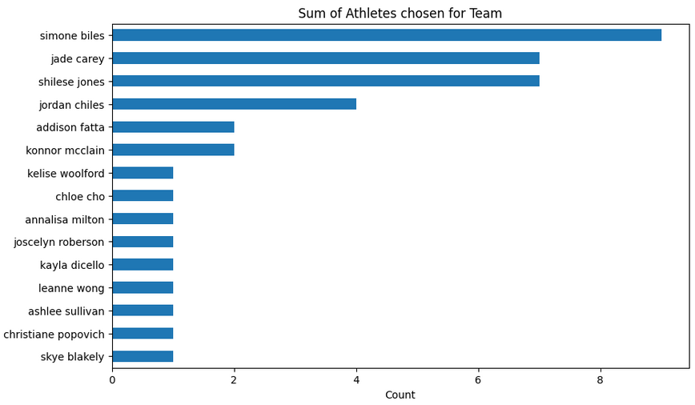
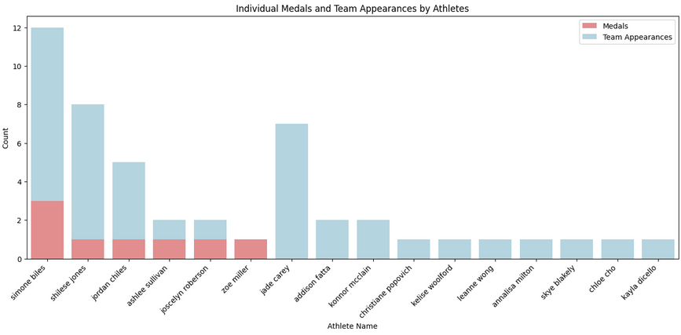
Evaluation Metrics woMen’s
Notes:
Individual Apparatus Evaluation and Results
This analysis draws upon historical data encompassing Men's and
Women's international gymnastics competitions. The models for
Women were trained on data spanning from 2013 to 2021, while the
models for Men were trained on a more limited timeframe from 2018 to
2020, due to time constraints. The evaluation of the models involves the
utilization of unseen data from the years 2022 and 2023 for inference.
4.2. Model Performance Metrics
For each apparatus, the data was run through the various models
(3.1.1.), and their accuracy, precision, F1-scores, and F2-scores were
compared. Once the best model was selected, judged by its accuracy
and F2-score, it was optimized using grid search for parameter tuning.
From there the data was scrutinized with feature importance. Although
the option of feature scaling was contemplated, the utilization of
AdaBoost and Random Forest classifiers for binary classification
demonstrated resilience to fluctuations in feature scales. As a result,
explicit scaling was deemed unnecessary in the analytical process. The
models underwent additional iterations to evaluate the potential for
improvements.
In addition to accuracy, I also evaluated the classifiers based on the
F2-score metric. The F2-score considers both precision and recall, with
a higher weight given to recall. It measures the overall effectiveness of
the classifier in selecting top gymnasts while minimizing false negatives.
The findings indicate that, across various gymnastics events, both the
Random Forest and AdaBoost classifiers consistently demonstrated
high accuracy. Moreover, both classifiers consistently attained elevated
F2-scores, emphasizing their proficiency in accurately identifying top
performers.
In summary, the Random Forest and AdaBoost classifiers consistently
demonstrated high accuracy and F2-scores in the selection process for
Team USA gymnasts. These findings highlight the effectiveness of
these classifiers in accurately identifying the top gymnasts while
minimizing false negatives. The results provide valuable insights for
improving the selection process and ensuring the inclusion of the most
deserving gymnasts in Team USA

Slide 13
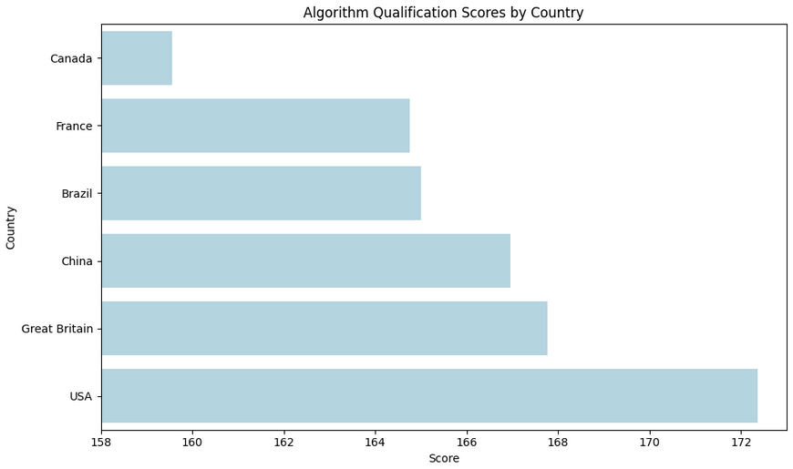
Evaluation Metrics Team
Notes:
Individual Apparatus Evaluation and Results
This analysis draws upon historical data encompassing Men's and
Women's international gymnastics competitions. The models for
Women were trained on data spanning from 2013 to 2021, while the
models for Men were trained on a more limited timeframe from 2018 to
2020, due to time constraints. The evaluation of the models involves the
utilization of unseen data from the years 2022 and 2023 for inference.
4.2. Model Performance Metrics
For each apparatus, the data was run through the various models
(3.1.1.), and their accuracy, precision, F1-scores, and F2-scores were
compared. Once the best model was selected, judged by its accuracy
and F2-score, it was optimized using grid search for parameter tuning.
From there the data was scrutinized with feature importance. Although
the option of feature scaling was contemplated, the utilization of
AdaBoost and Random Forest classifiers for binary classification
demonstrated resilience to fluctuations in feature scales. As a result,
explicit scaling was deemed unnecessary in the analytical process. The
models underwent additional iterations to evaluate the potential for
improvements.
In addition to accuracy, I also evaluated the classifiers based on the
F2-score metric. The F2-score considers both precision and recall, with
a higher weight given to recall. It measures the overall effectiveness of
the classifier in selecting top gymnasts while minimizing false negatives.
The findings indicate that, across various gymnastics events, both the
Random Forest and AdaBoost classifiers consistently demonstrated
high accuracy. Moreover, both classifiers consistently attained elevated
F2-scores, emphasizing their proficiency in accurately identifying top
performers.
In summary, the Random Forest and AdaBoost classifiers consistently
demonstrated high accuracy and F2-scores in the selection process for
Team USA gymnasts. These findings highlight the effectiveness of
these classifiers in accurately identifying the top gymnasts while
minimizing false negatives. The results provide valuable insights for
improving the selection process and ensuring the inclusion of the most
deserving gymnasts in Team USA

Slide 14
Evaluation Metrics men’s Team
Notes:
Individual Apparatus Evaluation and Results
This analysis draws upon historical data encompassing Men's and
Women's international gymnastics competitions. The models for
Women were trained on data spanning from 2013 to 2021, while the
models for Men were trained on a more limited timeframe from 2018 to
2020, due to time constraints. The evaluation of the models involves the
utilization of unseen data from the years 2022 and 2023 for inference.
4.2. Model Performance Metrics
For each apparatus, the data was run through the various models
(3.1.1.), and their accuracy, precision, F1-scores, and F2-scores were
compared. Once the best model was selected, judged by its accuracy
and F2-score, it was optimized using grid search for parameter tuning.
From there the data was scrutinized with feature importance. Although
the option of feature scaling was contemplated, the utilization of
AdaBoost and Random Forest classifiers for binary classification
demonstrated resilience to fluctuations in feature scales. As a result,
explicit scaling was deemed unnecessary in the analytical process. The
models underwent additional iterations to evaluate the potential for
improvements.
In addition to accuracy, I also evaluated the classifiers based on the
F2-score metric. The F2-score considers both precision and recall, with
a higher weight given to recall. It measures the overall effectiveness of
the classifier in selecting top gymnasts while minimizing false negatives.
The findings indicate that, across various gymnastics events, both the
Random Forest and AdaBoost classifiers consistently demonstrated
high accuracy. Moreover, both classifiers consistently attained elevated
F2-scores, emphasizing their proficiency in accurately identifying top
performers.
In summary, the Random Forest and AdaBoost classifiers consistently
demonstrated high accuracy and F2-scores in the selection process for
Team USA gymnasts. These findings highlight the effectiveness of
these classifiers in accurately identifying the top gymnasts while
minimizing false negatives. The results provide valuable insights for
improving the selection process and ensuring the inclusion of the most
deserving gymnasts in Team USA

Slide 15
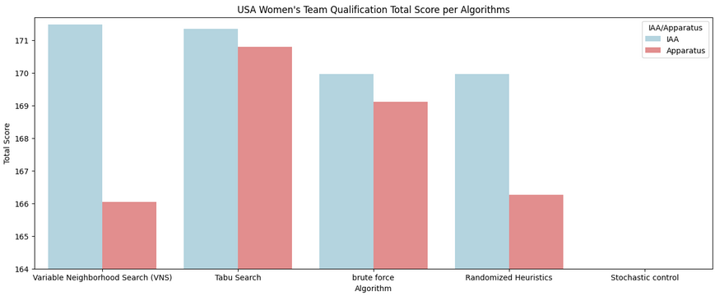
Evaluation Metrics women’s Team
Notes:
Individual Apparatus Evaluation and Results
This analysis draws upon historical data encompassing Men's and
Women's international gymnastics competitions. The models for
Women were trained on data spanning from 2013 to 2021, while the
models for Men were trained on a more limited timeframe from 2018 to
2020, due to time constraints. The evaluation of the models involves the
utilization of unseen data from the years 2022 and 2023 for inference.
4.2. Model Performance Metrics
For each apparatus, the data was run through the various models
(3.1.1.), and their accuracy, precision, F1-scores, and F2-scores were
compared. Once the best model was selected, judged by its accuracy
and F2-score, it was optimized using grid search for parameter tuning.
From there the data was scrutinized with feature importance. Although
the option of feature scaling was contemplated, the utilization of
AdaBoost and Random Forest classifiers for binary classification
demonstrated resilience to fluctuations in feature scales. As a result,
explicit scaling was deemed unnecessary in the analytical process. The
models underwent additional iterations to evaluate the potential for
improvements.
In addition to accuracy, I also evaluated the classifiers based on the
F2-score metric. The F2-score considers both precision and recall, with
a higher weight given to recall. It measures the overall effectiveness of
the classifier in selecting top gymnasts while minimizing false negatives.
The findings indicate that, across various gymnastics events, both the
Random Forest and AdaBoost classifiers consistently demonstrated
high accuracy. Moreover, both classifiers consistently attained elevated
F2-scores, emphasizing their proficiency in accurately identifying top
performers.
In summary, the Random Forest and AdaBoost classifiers consistently
demonstrated high accuracy and F2-scores in the selection process for
Team USA gymnasts. These findings highlight the effectiveness of
these classifiers in accurately identifying the top gymnasts while
minimizing false negatives. The results provide valuable insights for
improving the selection process and ensuring the inclusion of the most
deserving gymnasts in Team USA

Slide 16
Challenges and Limitations
Notes:
It is imperative to acknowledge the inherent constraints and limitations
that accompany the study. This section aims to transparently specify the
boundaries and potential sources of bias within the analysis, providing a
nuanced perspective on the scope and applicability of the findings.
This study does not consider the impact of injuries, or the physical toll
associated with participating in numerous events within a condensed
time frame. Omitting these factors may limit the comprehensive
understanding of athletes' capabilities, as injuries and physical fatigue
can significantly influence performance outcomes.
The complexity of team sports, such as gymnastics, extends beyond
individual performances. This analysis does not account for the
dynamics of team cohesion, which plays a crucial role in team-based
events.
The study employed historical data for Men's and Women's gymnastics,
with Women's models trained on a dataset spanning from 2013 to 2021
and Men's models trained on a dataset from 2018 to 2020. Including
data from the 2016 and 2020 Olympics provided a comprehensive
testing ground. However, the discrepancy, resulting from time
constraints, in the time span of data collection for Men's and Women's
models should not introduce bias, but is noteworthy to mention.

Slide 17
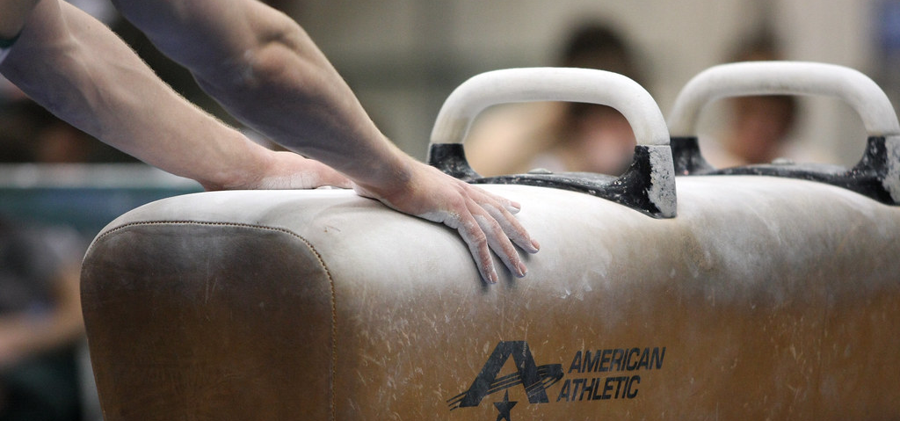
Future Research
Notes:
Conducting a more fine-grained analysis of individual features that
contribute to gymnastic performance could refine the models.
Investigating specific skills, techniques, or routine components and their
impact on outcomes could lead to more targeted and actionable insights
for athletes and coaches. Having a data set not only with the athlete’s
name, scores, penalties, and dates, but also which skills were
performed and at what point in their performance, as well as noting
combinations of skills and in which order.

Slide 18
Conclusion
Notes:
The exhaustive exploration of data scraping, cleaning, exploratory data
analysis (EDA), and modeling has unveiled significant insights into the
performance dynamics of both Men's and Women's USA Olympic
Artistic Gymnastics teams for the upcoming 2024 Paris Olympics. My
operational definition of "best," emphasizing the maximization of the
total medal count, has guided a meticulous investigation across
individual apparatus outcomes, team compositions, and strategic
positioning for Team USA.
In terms of individual events, a diverse collection of machine learning
models, encompassing Random Forest Classifier, AdaBoost Classifier,
Support Vector Classifier, among others, showcased nuanced
performances across various gymnastic disciplines. Results
underscored the effectiveness of the Random Forest and AdaBoost
classifiers, consistently displaying high accuracy and F2-scores,
affirming their robustness in the intricate process of selecting
top-performing gymnasts. These models demonstrated both reliability in
identifying winners and adaptability to handle inherent imbalances
within gymnastics datasets.
On the men's side, the optimization algorithms, including Tabu Search,
Randomized Heuristic, and Variable Neighborhood Search, contributed
valuable insights into the complexities of team composition. Results
indicated that Tabu Search and Variable Neighborhood Search (VNS)
algorithms, particularly when utilizing Individual All-Around (IAA) scores,
emerged as the highest-scoring algorithms. These findings provide a
comprehensive understanding of the intricate decision-making
11
processes involved in the selection of gymnasts for the Men's Team
USA.
Meanwhile, the evaluation of the Women's Team revealed a potential
gymnastics powerhouse for the 2024 Olympics, projecting an
impressive total of eight medals. This includes both individual accolades
and team achievements. The combination of individual gymnast
predictions and team dynamics highlighted the multidimensional nature
of gymnastics performance, showcasing the prowess of athletes like
Simone Biles, Shilese Jones, and Jordan Chiles, among others.

